Slide 1

EMI Filters: Ensuring Clean Power & EMC Compliance

Slide 2

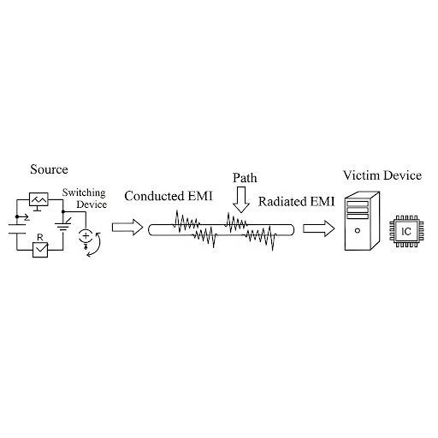
What is EMI?
- Electromagnetic Interference (EMI): unwanted electrical noise
- Sources: switching devices, motors, power electronics, communication systems
- Paths: Conducted (via wires) and Radiated (via air)

Slide 3
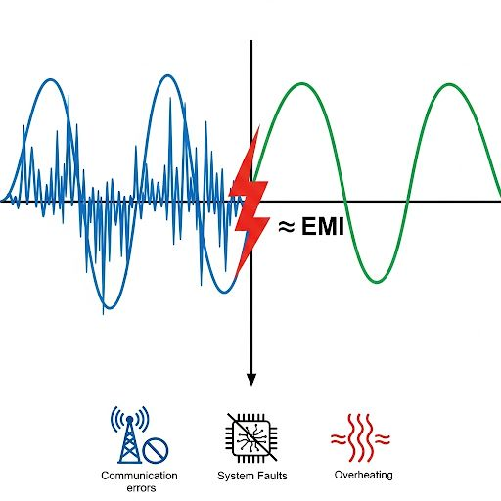
Why EMI is a Problem
- Malfunction of sensitive devices
- Communication errors
- Reduced equipment reliability
- Regulatory non-compliance (CISPR, FCC, CE, MIL-STD)

Slide 4
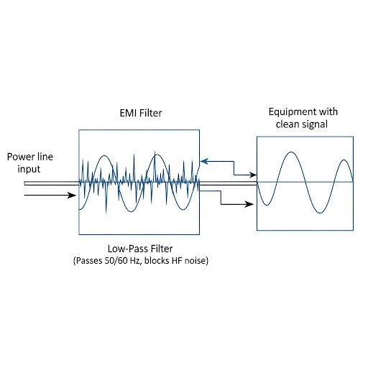
What is an EMI Filter?
- Passive electronic filter suppressing high-frequency noise
- Passes 50/60 Hz power, blocks HF noise
- Placement: between power line and equipment

Slide 5
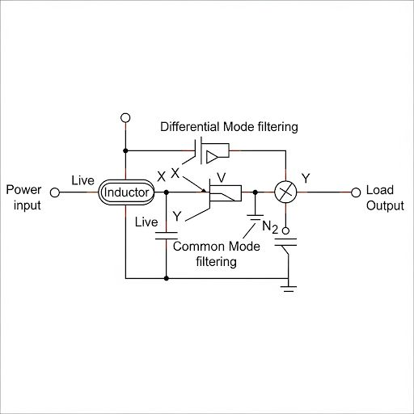
EMI Filter Structure
- Components:
- Inductors (chokes): block HF currents
- Capacitors: shunt noise to ground
- Types: Differential mode vs Common mode

Slide 6
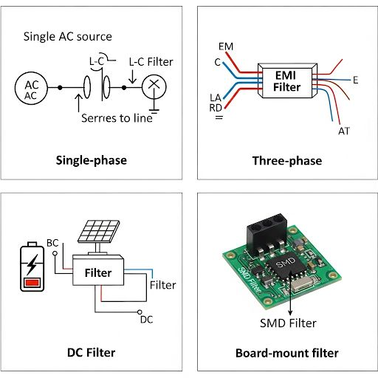
Types of EMI Filters
- Single-phase filters → home appliances, office equipment
- Three-phase filters → industrial automation, motor drives
- DC filters → solar inverters, EV chargers
- Board-mount filters → compact electronics

Slide 7
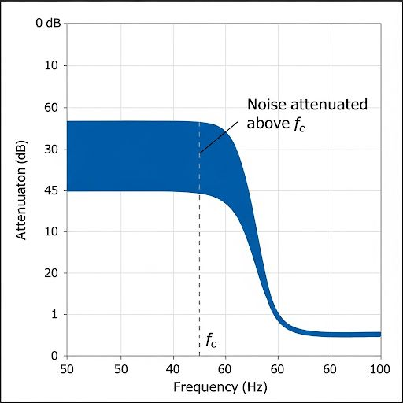
Working Principle
- Acts as low-pass filter: passes 50/60 Hz, attenuates HF noise
- Differential mode noise → X-capacitors + series inductors
- Common mode noise → common-mode chokes + Y-capacitors

Slide 8
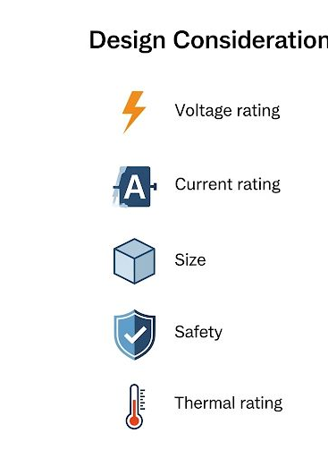
Design Considerations
- Voltage & current rating
- Insertion loss (attenuation performance)
- Safety standards (UL, CE)
- Size and thermal performance
- Leakage current (esp. medical)

Slide 9
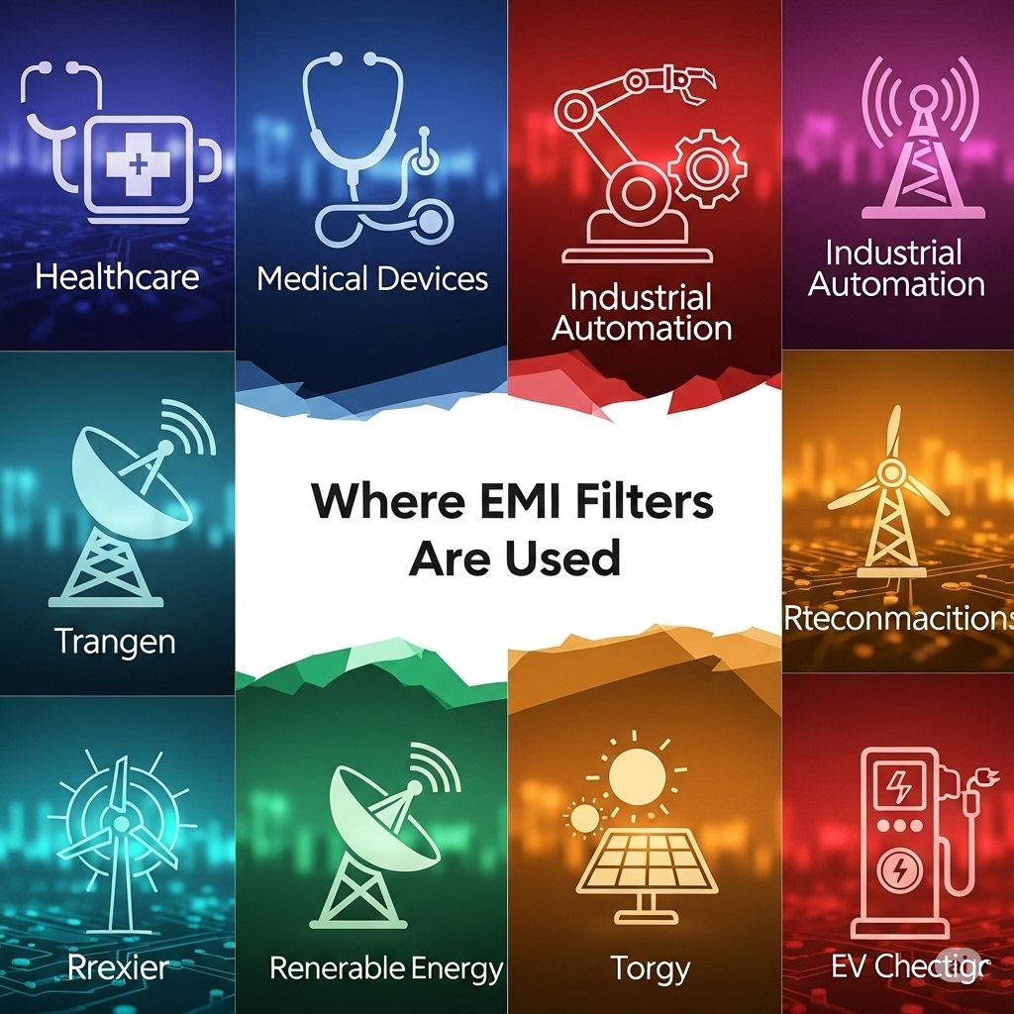
Applications
- Medical equipment
- Industrial automation
- Data centers & telecom
- Renewable energy (solar/wind inverters)
- Automotive (EV chargers, onboard electronics)

Slide 10
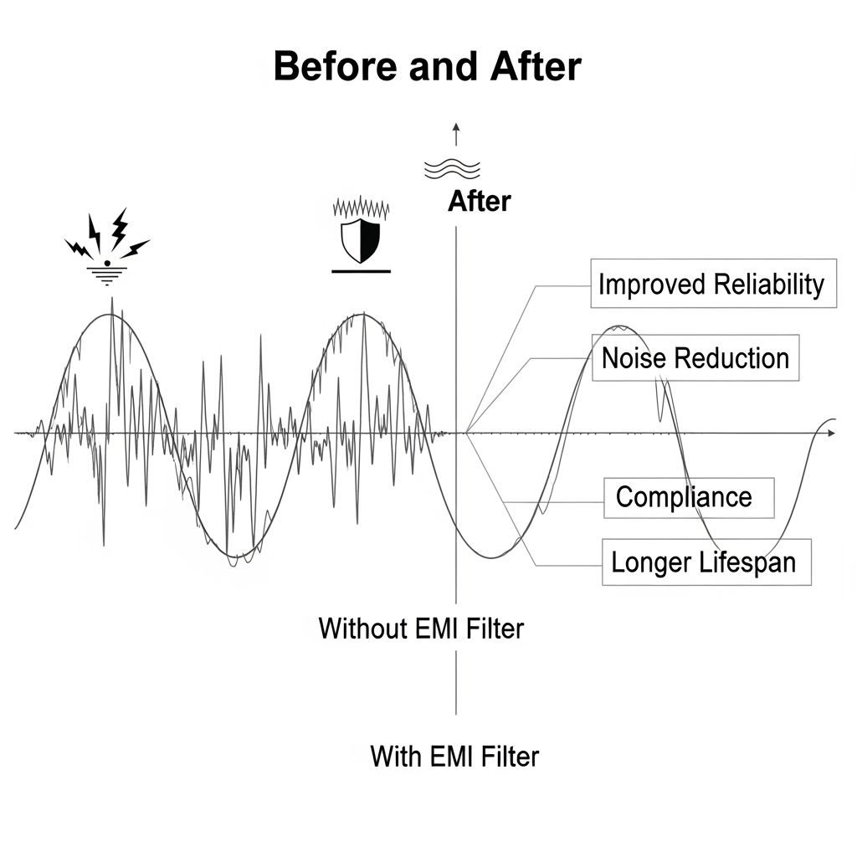
Benefits
- Ensures EMC compliance
- Improves equipment reliability
- Reduces noise & distortion
- Protects sensitive devices
- Extends equipment lifespan

Slide 11



























































Our Clients:

Slide 12




Thank you !
PurityElec Private Limited, 001-002, 1st Floor, C1 Tower, Engineers Enclave, Haldoni Mod, Greater Noida – 201306 (U.P.)
(+91) 8588001002 / 8588002004
support@purityelec.com
sales@purityelec.com
purityelec.com

